Slide 1
PREDICTING loan approval
LHL Week 10 presentation
Emily Stickland

Slide 2
AGENDA
Introduction and goals
Data Preparation and EDA
Logs and Scaling
ML Models and Challenges
Evaluating Models
Areas for future research

Slide 3
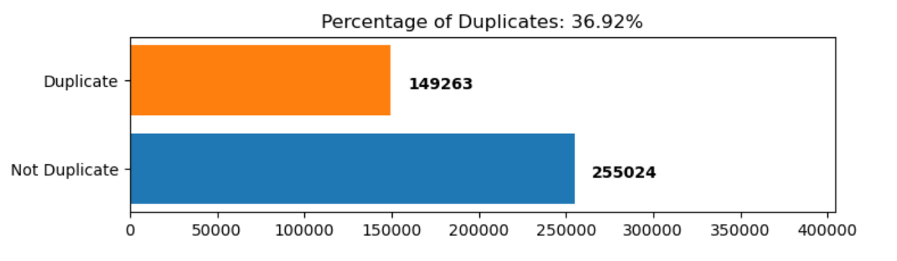
Exploratory data analysis
No exact matches between columns Q1 and Q2, but many exact matches within columns
Only 2 NaNs - dropped
Imbalanced dataset

Slide 4
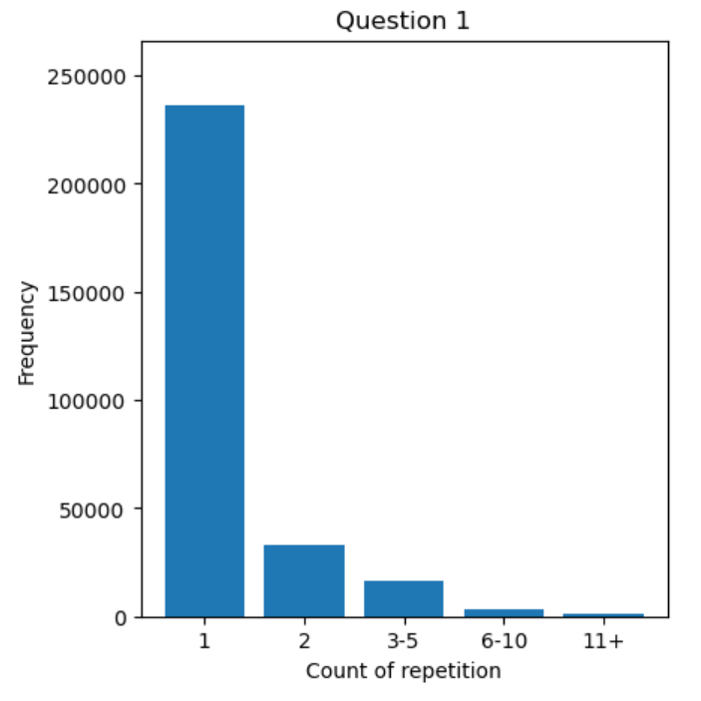
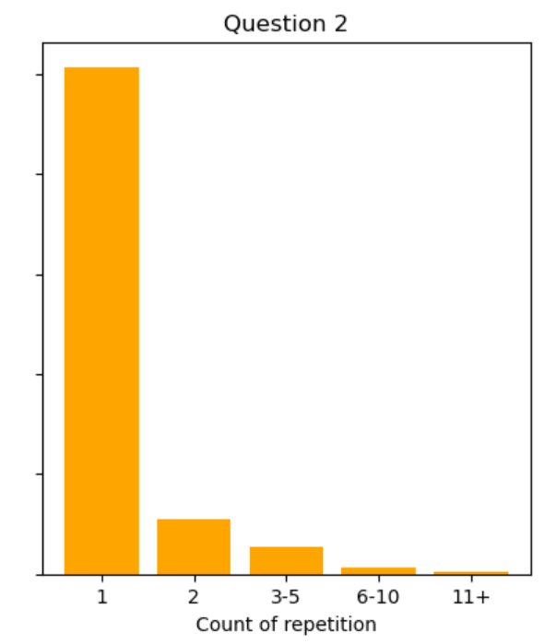
EDA: DUPLICATES

Slide 5
EDA: LANGUAGE ANALYSIS
Progress bars don’t always lead to progress

Slide 6
DATA CLEANING – KEEPING Q1 AND Q2 SEPARATE
Making lowercase
Word tokenizing
Removing non-alpha characters using word.isalpha()
Filtering out stop words
Filtering out words with < 2 characters
Stemming words using PorterStemmer()

Slide 7
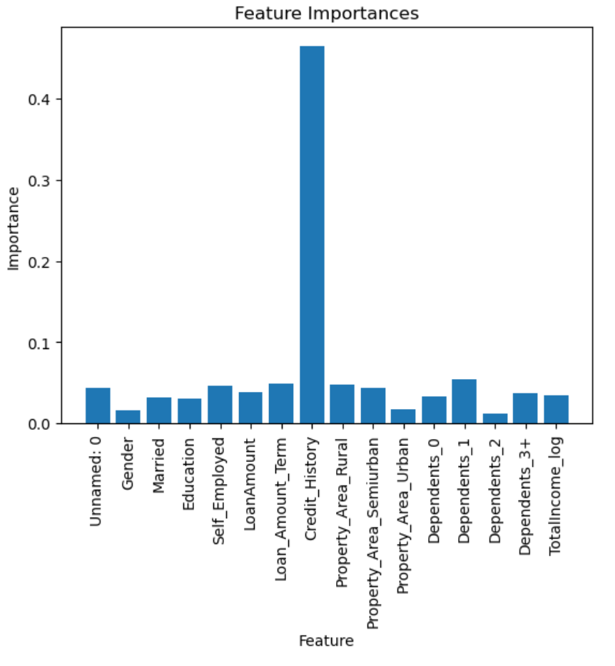
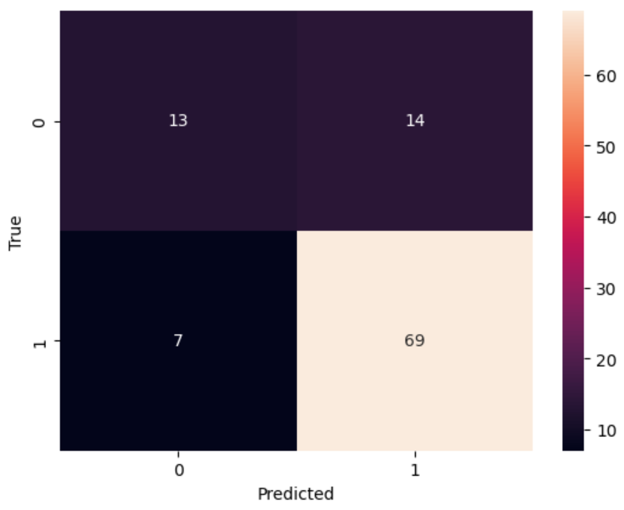

MODELLING – XG BOOST

Slide 8
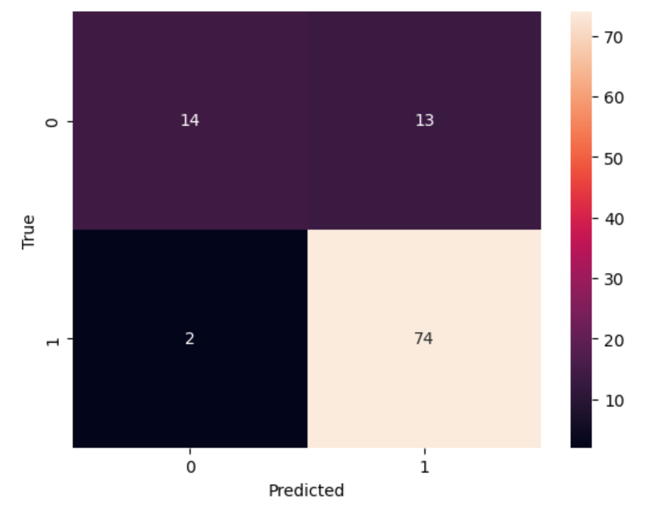
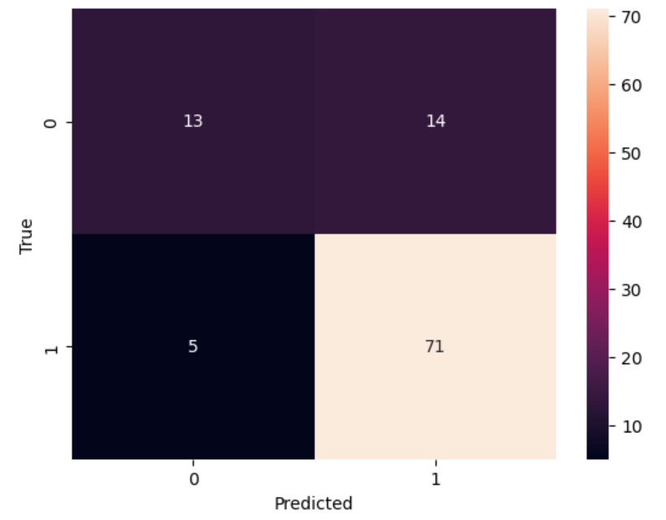
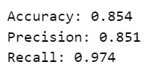

MODELLING
Naïve Bayes
Random Forest

Slide 9
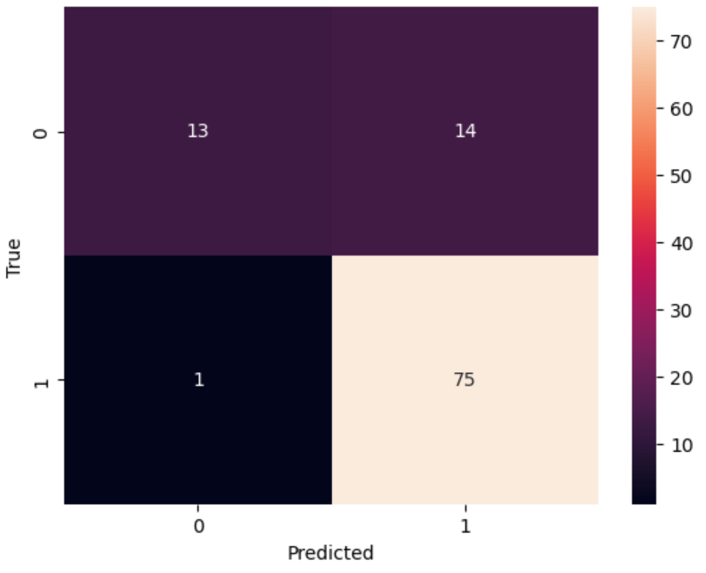

MODELLING
Logistic Regression

Slide 10
Areas for future analysis
Do different encoding types change the outcome?
Why didn’t scaling affect the results? Both Standard and Min-Max
How do the default args affect the results – Grid Search to tune the parameters
Pipelines

